Slide 1
Chest Radiograph Pneumothorax Pneumomediastinum
Presentor: Dr Malindi
Supervisor: Dr Mwango
22ND JAN 2020

Slide 2
OUOTOUTLINEObjectives
Recognizing an adequate film
Review of basic chest radiographic anatomy
Apply a checklist methodology of chest x-ray interpretation
Review specific points and pitfalls of pediatric chest x ray interpretation including tubes and lines and evaluation for pneumothorax and pneumomediastinum
Chest tubes and Catheters
Umbilical venous and arterial catheters

Slide 3
Recognizing a Technically Adequate Chest Radiograph
Important … technical deficiencies can mimic pathologies.
Penetration - You should see thoracic spine through heart shadow.
Underpenetrated (too light) studies obscure left lung base &tend to spuriously accentuate lung markings;
over penetrated studies (too dark) may mimic emphysema or pneumothorax.
Inspiration- You Should see at least 8 to 9 posterior ribs.
?DIFFERENTIATING BETWEEN ANTERIOR AND POSTERIOR RIBS.
Poor inspiratory efforts may mimic basilar lung disease and may make the
heart appear larger.

Slide 4
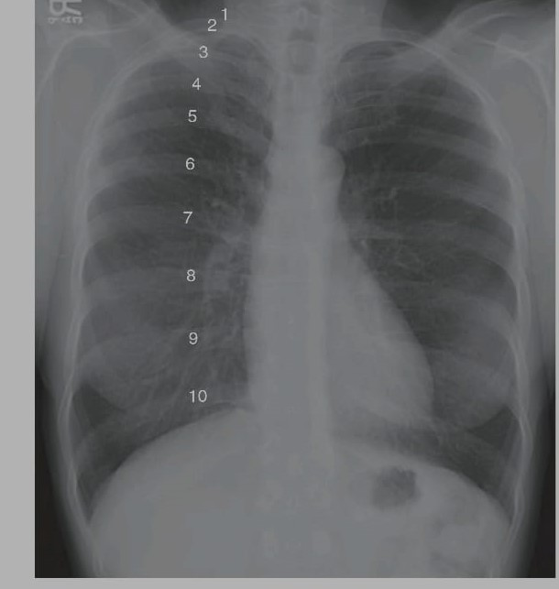

Slide 5
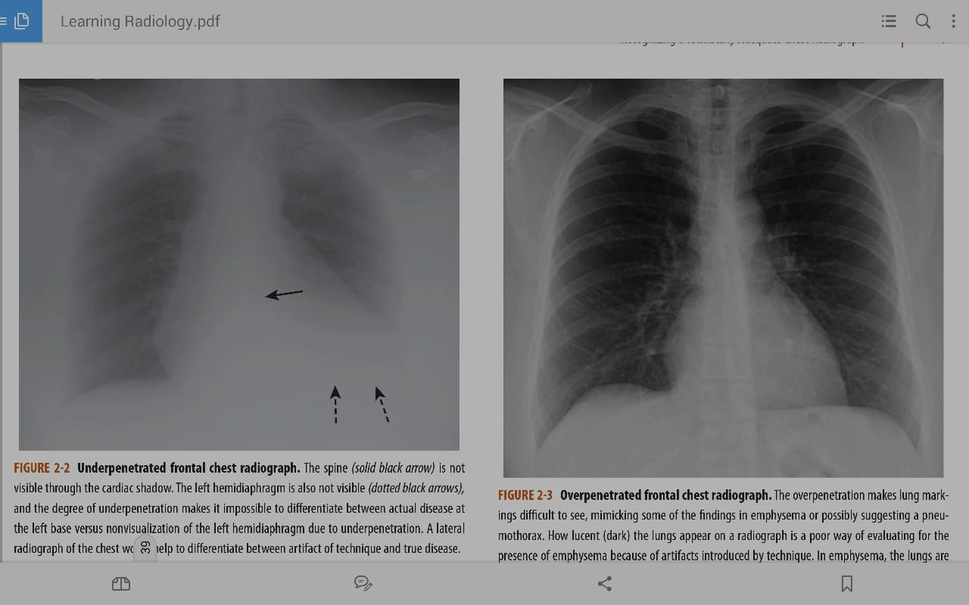

Slide 6
Rotation- Spinous process should fall equidistant between the medial ends of the clavicles.
Rotation can introduce numerous artifactual anomalies affecting the contour of
the heart and the appearance of the hila and diaphragm.
Magnification- Anteroposterior films (mostly portable chest x-rays)magnify the heart slightly.
Angulation - Clavicle normally has an S shape, and medial end
superimposes onto the 3rd or 4th rib

Slide 7
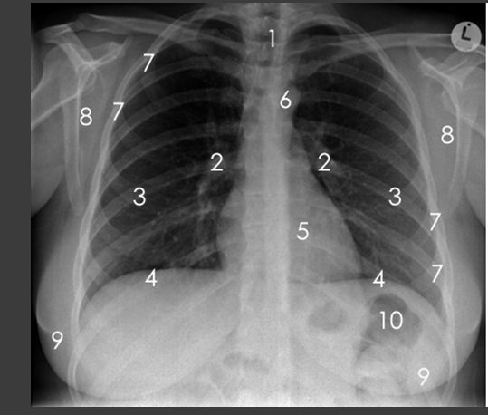
Notes:
1)Trachea 6)aortic knuckle
2-hila 7)ribs
3-lungs 8)scapulae
4-diaphragm 9)breasts
5-heart 10) bowel gas

Slide 8
Normal anatomy of the chest by conventional radiography You only see what you look for, and you only look for what you know. 2 Views are common, PA and lateral Views. Vessels, Trachea, and bronchi—normal lung markings Pleura—normal anatomy Heart contours and diaphragm Bonny structures and Soft tissues of the chest wall Visualized parts of the abdomen

Slide 9
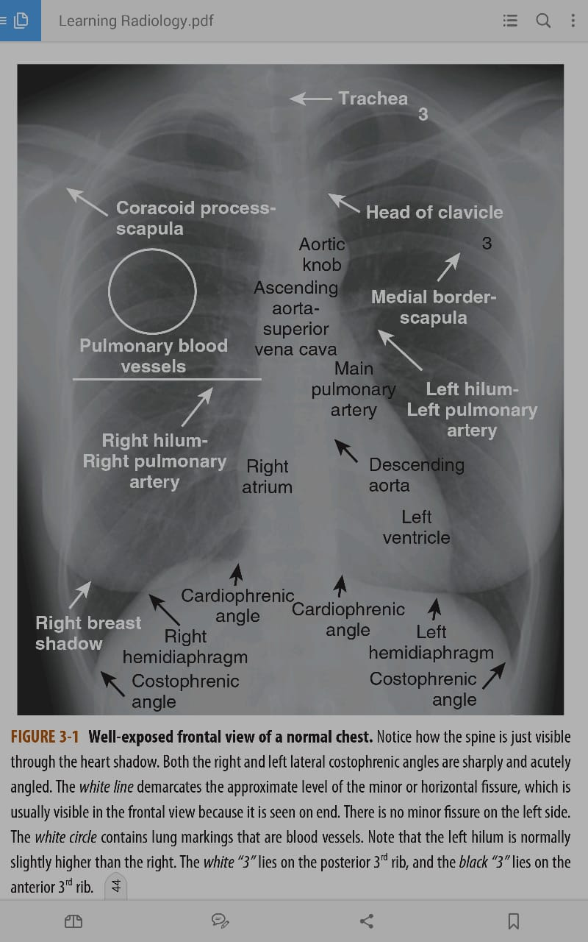

Slide 10
Five Key Areas on the Lateral Chest X-Ray
The retrosternal clear space
The hilar region
The fissures
The thoracic spine
The diaphragm and posterior costophrenic sulci

Slide 11
Notes:
1)Trachea 6)aortic knuckle
2-hila 7)ribs
3-lungs 8)scapulae
4-diaphragm 9)breasts
5-heart 10) bowel gas

Slide 12
CHEST RADIOGRAPH CHECKLIST CHECKLIST
A-Airway-Midline,no obvious deformities
B-Bones and Soft tissues(no fractures,subcutaneous emphysema)
C-Cardiac size
D-Diaphragms-Right above left by 1cm to 3cm,costophrenic angles sharp)
E-Equal volume-(Count ribs,look for mediastinal shift)
F-Fine detail (Pleura and lung parenchyma)
G-Gastric bubble
H-Hilum(Left normally above right by 3cm
H-Hardware-tubes and lines

Slide 13
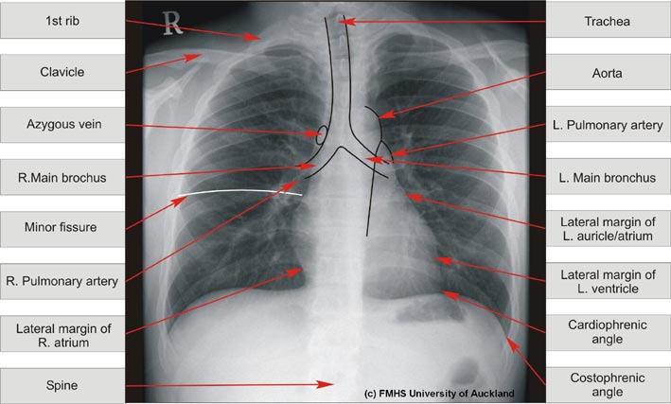

Slide 14
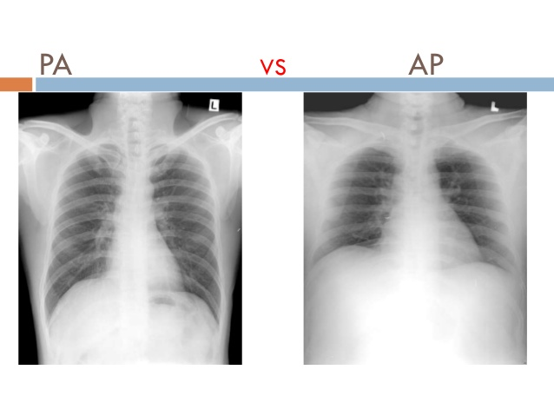
Notes:
AP view- 1. Clavicle remains at top of lung field 2. Ribs lie more horizontal 3. Scapula comes in the lung field 4. Heart shadow looks larger 5. Usually bedridden and infants
PA view- 1. Clavicle in lung field 2. Ribs slanted 3. Scapula outwards from lung field 4. Heart shadow smaller 5. Usual view

Slide 15
Notes:
1-penetration-should be able to see the spine through the heart
2-inspiration-should see at least 8 to nine posterior ribs
3-Rotation –spinous process should fall equidistant between the medial ends of the clavicles
4-Magnification-Anteroposterior films magnify the hert slightly
5-Angulation-clavicle normally has an s-shape and the medial ends superimpose onto the 3rd or 4th rib

Slide 16
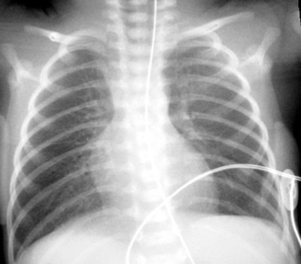
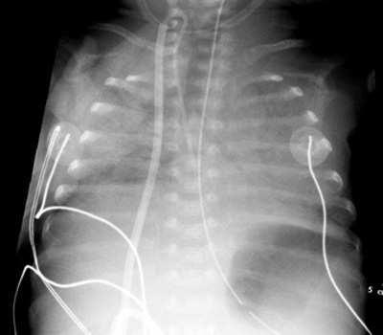

Slide 17
Pneumothorax
Occurs when air enters the pleural space.
Parietal pleura remains close to inner surface of chest wall, but visceral pleura retracts toward hilum with collapsing lung.
Visceral pleura becomes visible as a thin
white line outlined by air on both sides.
You must identify visceral pleural line to make definitive diagnosis of a pneumothorax.

Slide 18
Pneumothorax…cont
There is usually, but not always, an absence of lung markings peripheral to the visceral pleural line.
The presence of an air–fluid interface in the pleural space is often an indication that there is a pneumothorax present.

Slide 19
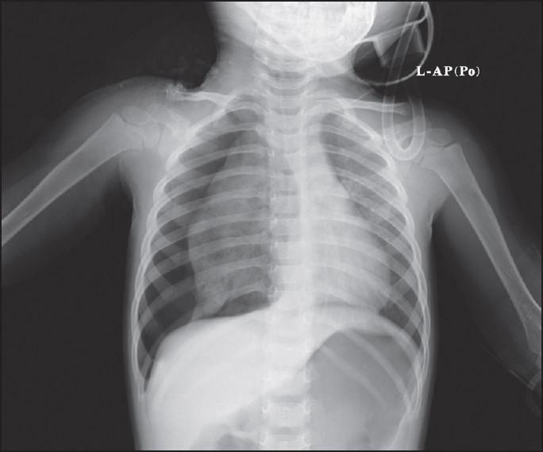
Notes:
Pneumothorax refers to presence of gas in the pleural space
Classically a pneumothorax appears as an area of radiolucency between the edge of the lung and the chest wall and absence of lung markings peripherally.

Slide 20
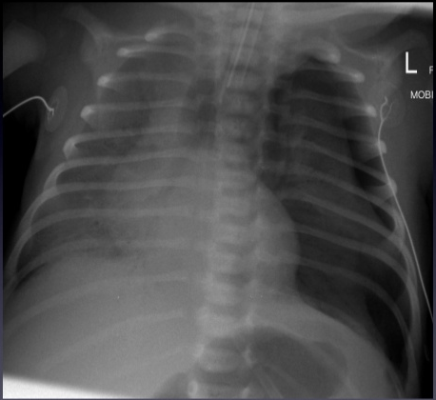

Slide 21
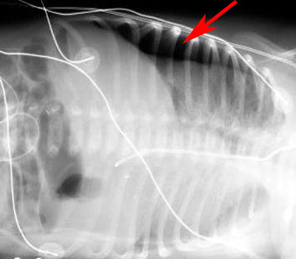
Notes:
Right pneumothorax confirmed with a left decubitis CXR

Slide 22
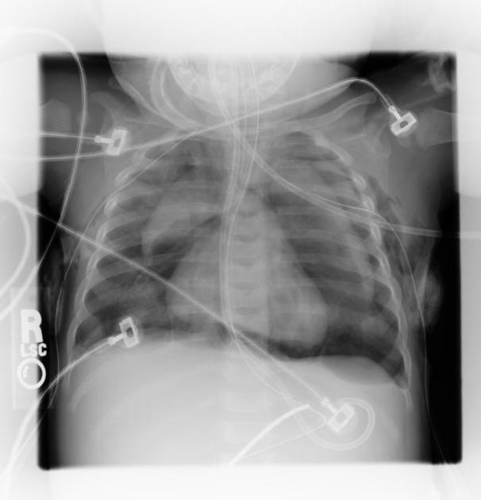
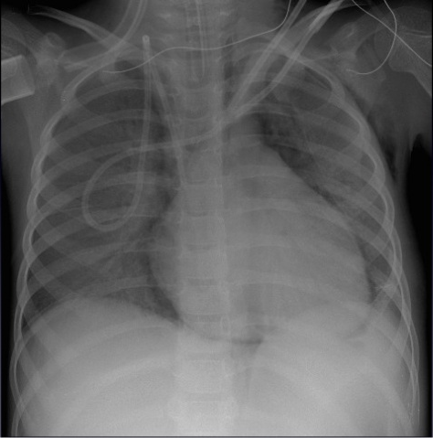
Notes:
Pneumomediastinum is the presence of extraluminal gas within the mediastinum. Gas may originate from the lungs, trachea, central bronchi, oesophagus, and peritoneal cavity and track from the mediastinum to the neck or abdomen
It can also be as a result of a complication of pneumothorax
gas anterior to pericardium: pneumopericardium
continuous diaphragm sign: due to gas trapped posterior to pericardium

Slide 23
Summary; features of pneumothorax;
Visualization of the visceral pleural line—a must for the diagnosis.
Absence of lung markings distal to the visceral pleural line (most times)
The presence of an air–fluid interface in the pleural space.

Slide 24
PNEUMOMEDIASTINUM
Occurs when is in the mediastinum.
May develop secondary to perforation of air-containing viscus in the mediastinum e.g esophagus or tracheobronchial tree.

Slide 25
Radiographic findings of pneumomediastinum
Linear, streak like lucency associated with a thin white line paralleling the left heart border.
Streaky air outlining the great vessels (aorta,
SVC, carotid arteries)
Linear streaks of air parallel to spine in upper thorax extending into neck and surrounding esophagus and trachea.
Continuous diaphragm sign.

Slide 26
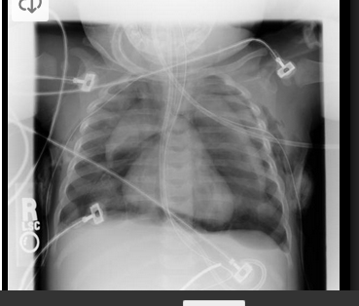
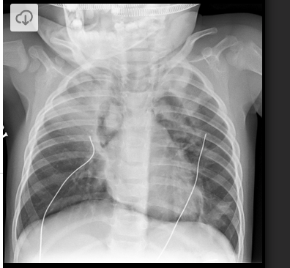

Slide 27
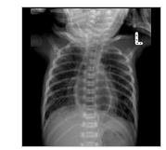

Slide 28
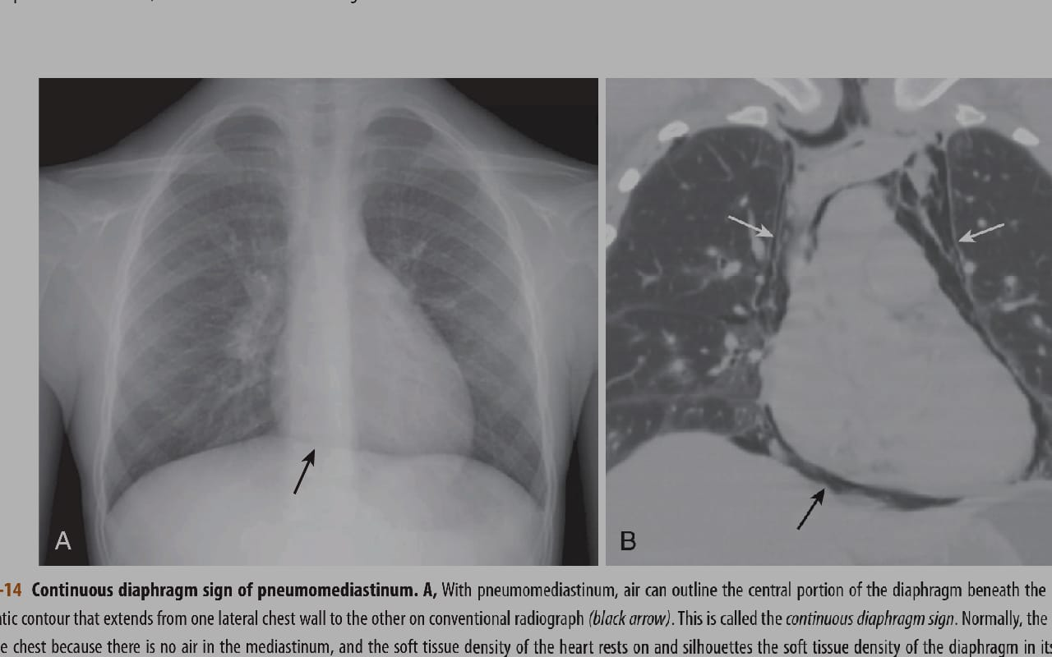

Slide 29
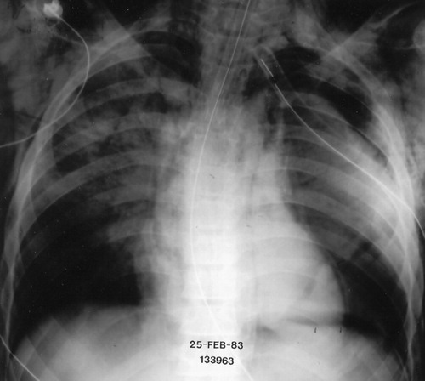

Slide 30
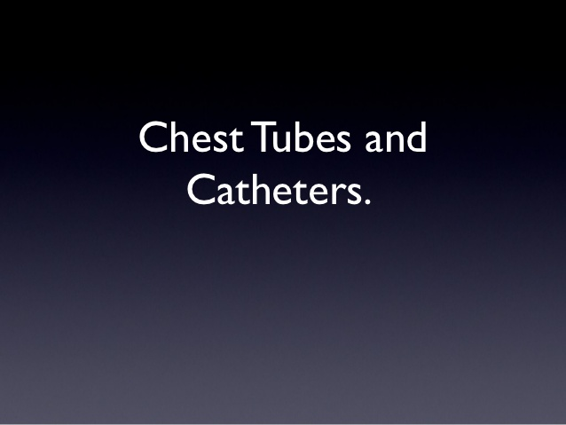

Slide 31
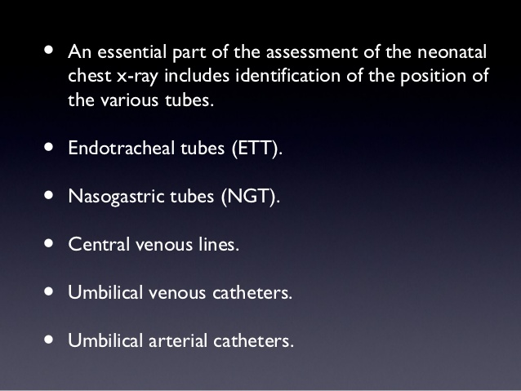

Slide 32
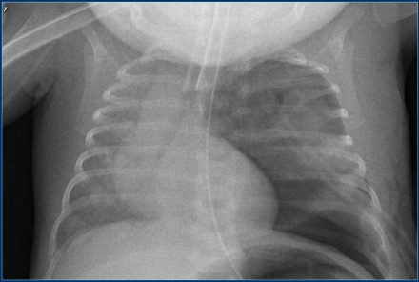
Notes:
1)The tip of an endotracheal tube should be 1 cm above the carina.
The most common malpositioning is in the right mainstem bronchus, because of the shallower angle of the right main bronchus.
Here a good positioned tube in a patient with a pneumothorax on the left.

Slide 33
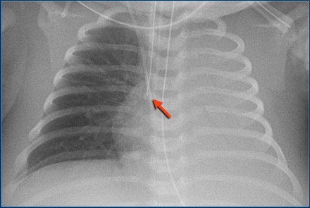
Notes:
Right mainstem bronchus intubation with atelectasis of the entire left lung.

Slide 34
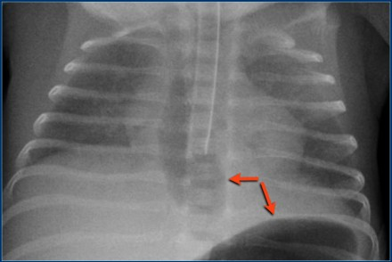
Notes:
Endotracheal tube is positioned in the oesophagus.
Chest radiograph shows dilatation of the esophagus and stomach, that are filled with air (arrows).

Slide 35
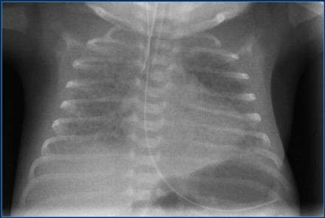
Notes:
NG tube should be positioned with the tip in the stomach.

Slide 36
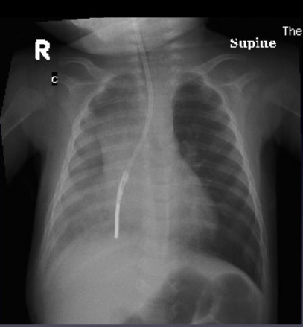

Slide 37
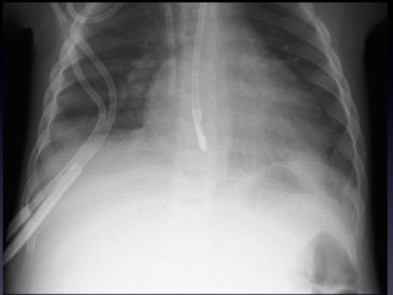

Slide 38
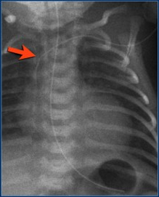
Notes:
A peripheral inserted central catheter or PICC line is positioned in the great vessels, preferably in the superior or inferior caval vein.
The lumen of the line was filled with contrast, showing the tip of the line high in the superior caval vein.

Slide 39
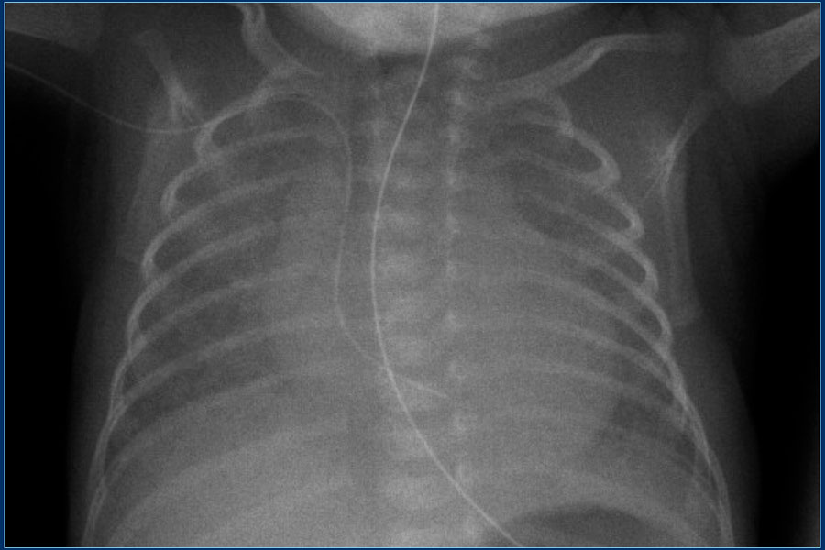
Notes:
Malpositioned PICC line in the right atrium.

Slide 40
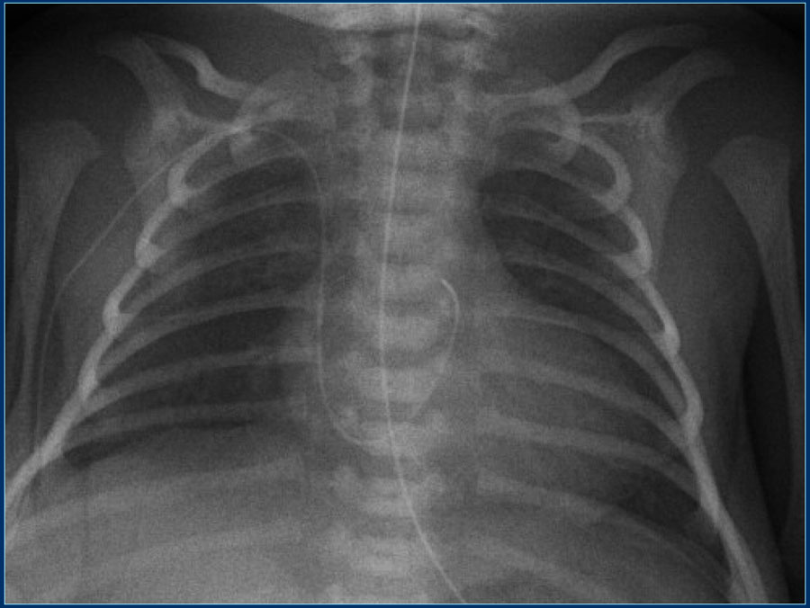
Notes:
Malpositioned PICC line. Probably located in the coronary sinus or in the left atrium after passing through a patent foramen ovale.

Slide 41
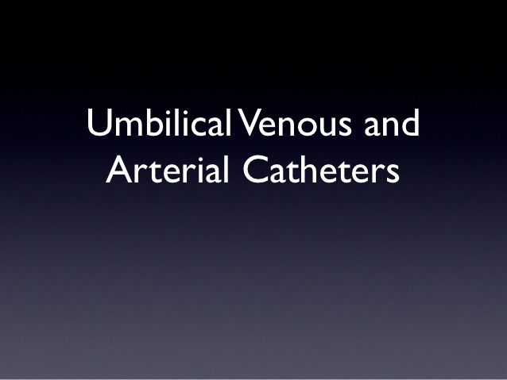

Slide 42
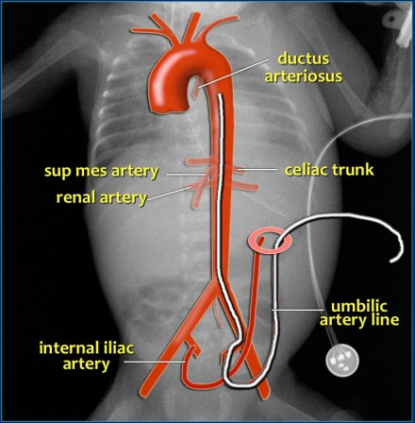
Notes:
Umbilical artery catheterization provides direct access to the arterial system and allows accurate measurement of arterial blood pressure, blood sampling and intravascular access for fluids and medications.
The catheter should be passed through the umbilic artery and enter the aorta via the internal iliac artery. It should demonstrate the typical loop from the umbilicus inferiorly into the internal iliac artery.
In order to avoid placement into aortic branches, the catheter should be either in a high position above the celiac, mesenteric and renal arteries or in a low position below the inferior mesenteric artery:
high position: T6-T9
low position: L3-L5

Slide 43
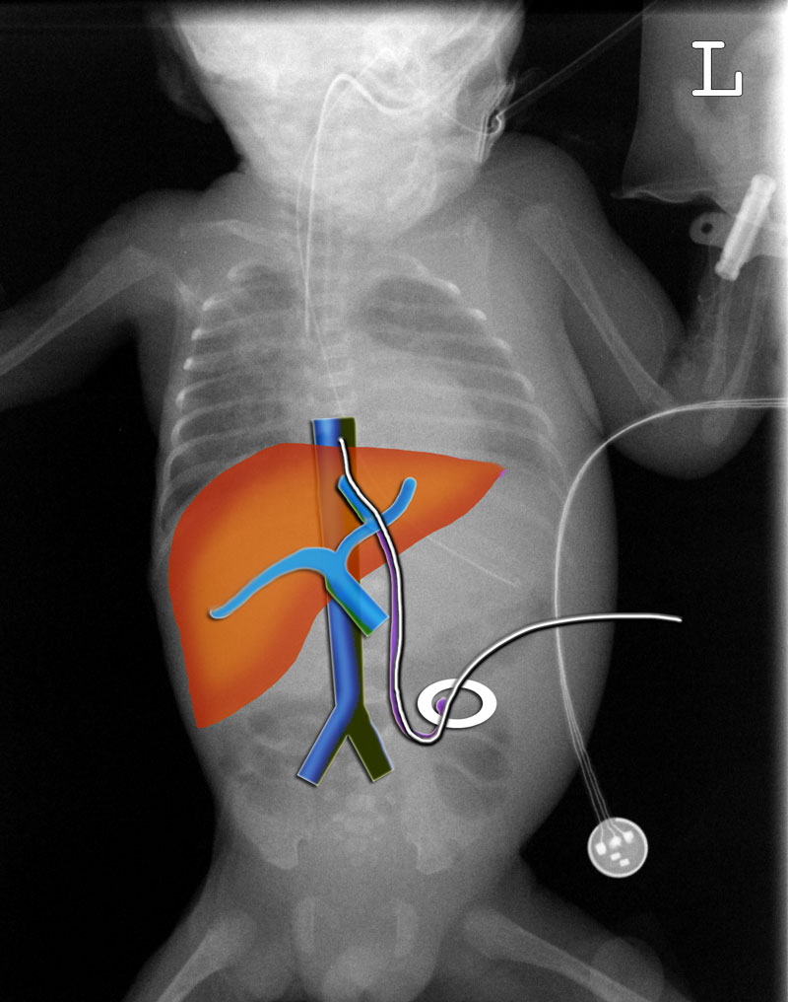
Notes:
An umbilical vein catheter should pass through the umbilic vein into the left portal vein. Then through the ductus venosus into a hepatic vein and the inferior caval vein (IVC).
The tip should be positioned in the IVC at the level of the diaphragm.

Slide 44
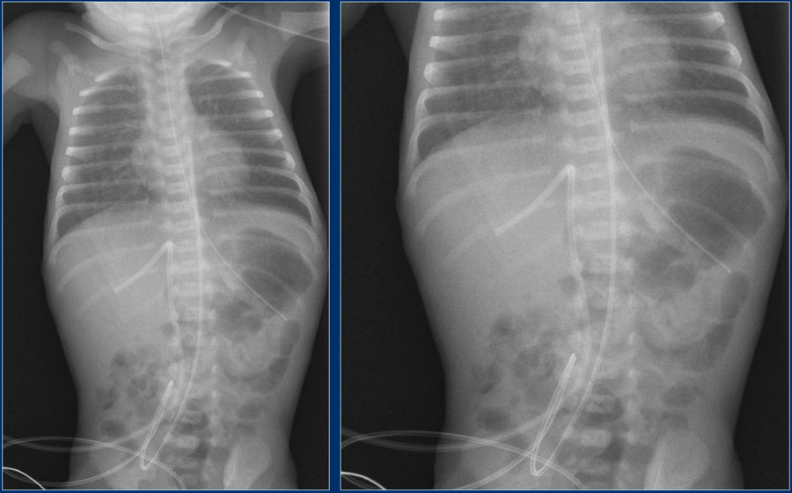
Notes:
Umbilical artery line in a good high position.
Malposition of umbilical vein line in right portal vein.

Slide 45
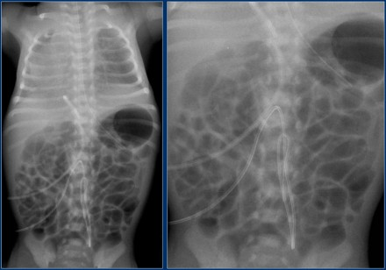
Notes:
Malposition of umbilical artery line, folded in the abdominal aorta.

Slide 46
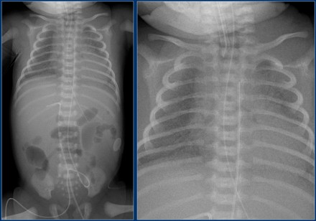
Notes:
Deep position of umbilical artery line, in aortic arch.
Umbilical vein line with tip in right portal vein.

Slide 47
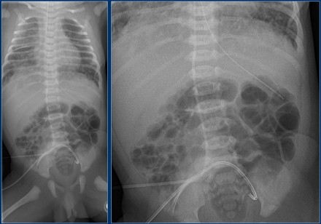
Notes:
Malposition of umbilical artery line in left iliac artery.
Deep position of umbilical vein line in right atrium.

Slide 48
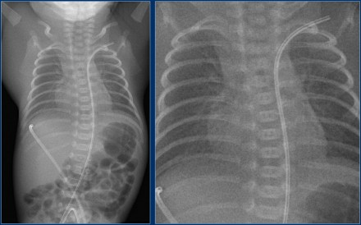
Notes:
Umbilical vein line positioned in the periphery of the liver through the right portal vein.
Artery line in the left subclavian artery.

Slide 49
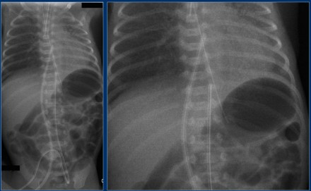
Notes:
The umbilical venous line is too deep and positioned in the right atrium.
The umbilical arterial line is at the level of T10 (preferrably at level T6-T9).
The endotracheal tube is positioned too deep. It should be 1 cm above the trachea bifurcation.

Slide 50
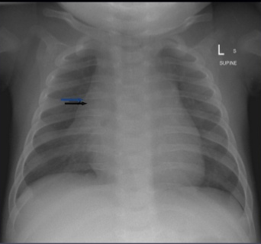
Notes:
The thymus is seen as a triangular sail (thymic sail sign) frequently towards the right of the mediastinum. It has no mass effect on vascular structures or airway.
The thymus is normally prominent on chest films during the first few years of life
And starts becoming less noticeable after 3-4 yrs of age
It can be clearly visible to the right or the left or on both sides of the mediastinum
Found in the anterior mediastinum

Slide 51
References;
Learning Radiology RECOGNIZING THE BASICS 3rd EDITION. William Herring, MD, FACR.
University of Virginia
DDIRM

Slide 52
Q & A

Slide 53
THANK YOU

